Slide 1
ERAU Project Midterm Update
Drone Behavior Classification Traffic Anomaly Detection

Slide 2
Drone Behavior Classification
Classification of UAS based on Ensemble Empyrical Mode Decomposition (EEMD)
Data: 36 “flights” (straight, surround, none), 1280 features
Video and control signals captured > STFT and EEMD > Normalized
White noise data added signals are same as signal present
Feature engineering data (drone presence, multiple drones, drone behavior)
Train and fit NN models (Tensorflow/Keras)
Several methods have been attempted to achieve greater accuracy
Masking of IMF features
Model tuning
Dimensionality reduction

Slide 3
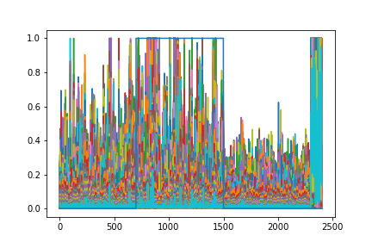
Normalized Signal by time-step

Slide 4

Preliminary Results – Behavior Classification
Flip a coin, our models are as good as that…

Slide 5
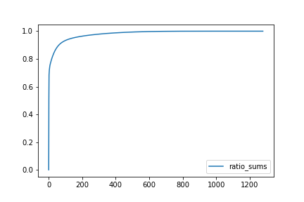
Preliminary Results – Presence Classification
Binary Classification: Model accuracy ~89%
PCA adds no accuracy (200 Components ~ 96% variance explained)
Optimization (SGD)
Sigmoid activation function: output

Slide 6
Next Steps
Tune models to achieve higher presence classification
Transformation of signal data to perform behavior classification
Get lots of flights > treat data as image data?

Slide 7
Traffic Anomaly Detection
SDR project scrapped due to inability to collect data
New project using NSL-KDD optimized dataset
Several techniques have already been successful
(SVM, RF, MLP, Naive Bayes, etc.)
In initial stages of data processing and cleaning
Next steps: feature engineering and model building

Slide 8




Questions?

